Slide 1

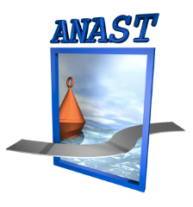
ANAST
UNIVERSITY of LIEGE
Ph. RIGO, Univ. of Liege
SHIP STRUCTURE OPTIMIZATION
METHANIER

Slide 2
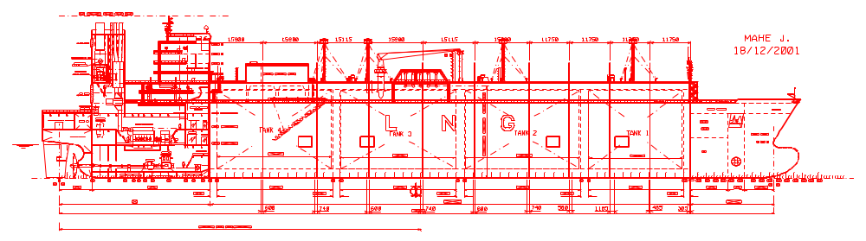

Medium Size LNG Carrier
60 000 Elements
150 Panels
40 Blocs
Indicative values
220 m

Slide 3
Méthanier
MONTAGE DU NAVIRE

Slide 4
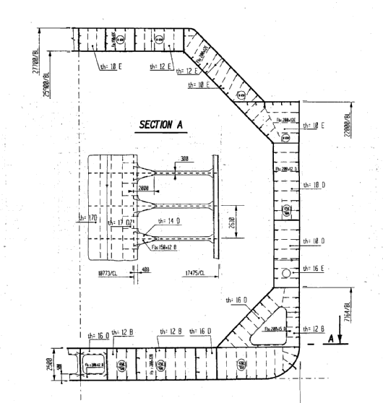
Medium Size LNG Carrier
VERSION INITIALE
MID-SHIP SECTION

Slide 5
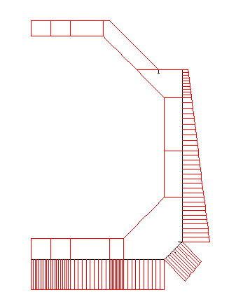
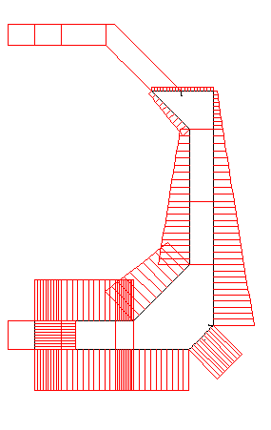
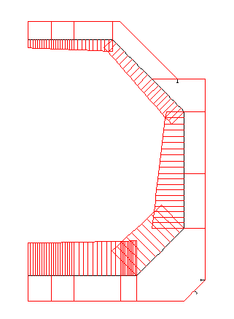
Medium Size LNG Carrier
Dynamic Internal
Pressure
in GAS Tank
(BV’s rules)
Internal pressure
in BALLAST
(BV’s rules)
Sea Loads
(BV’s rules)

Slide 6
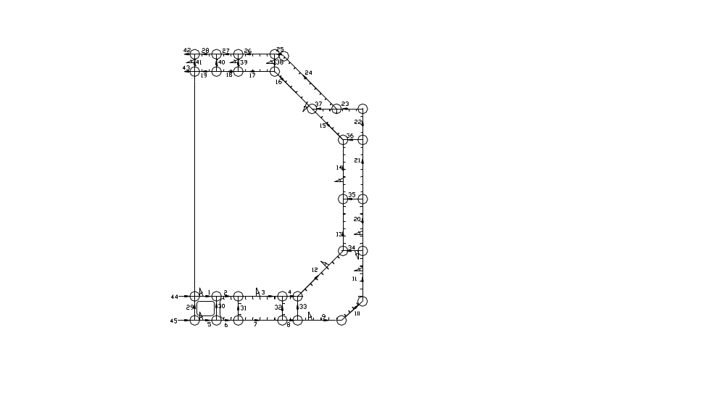
Medium Size
LNG Carrier
LBR5
Mesh Model
ANAST ULg

Slide 7
Medium Size LNG Carrier
The mesh model of the gas carrier includes:
41 stiffened panels with 9 design variables each,
4 additional panels to simulate the sym. axis,
278 design variables (5 to 9 variables per panel);
106 equality constraints between design variables are used, e.g., to impose uniform frame spacing for the deck, bottom and the side ballast tanks.
203 geometrical constraints (about 5 to 6 x 41 panels).
For instance longitudinal web heights are limited by such constraints to control the web slenderness.
ANAST ULg

Slide 8
Medium Size LNG Carrier
1900 structural constraints (380 per load case):
- σ_{c} frame & σ_{c} stiffener (web/plate junction – web/flange junction and flange),
- σ_{c} plate , to check if σ_{c} ≤ s₁.σ_{o} (with s₁ a partial safety factor and σ_{o} the yield stress);
- Local plate buckling: δ_{MIN} ≤ δ (with δ_{MIN} the minimum plate thickness to avoid buckling and local yielding);
- Ultimate strength of stiffened panel: σ/ σ_{ULT} ≤ s₂ with s₂ a partial safety factor.
ANAST ULg

Slide 9
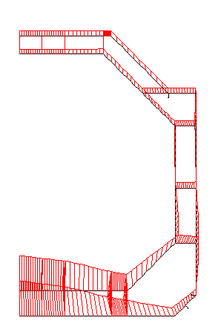
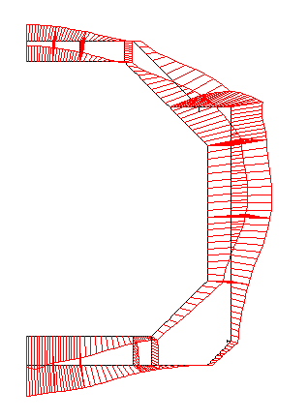
Medium Size LNG Carrier
Deflections (Frame bending)
Maximum
Bending
of the
double bottom
Max. Bending
of the
side tank

Slide 10
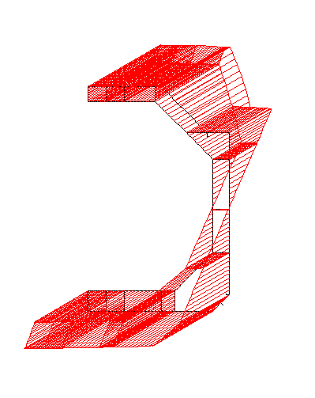
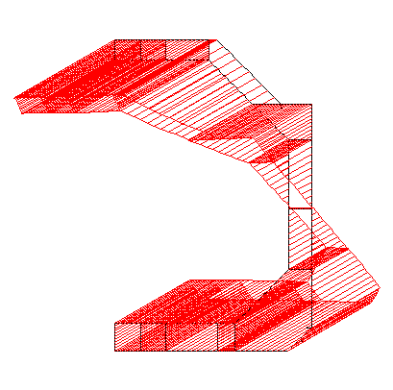
Medium Size LNG Carrier
Longitudinal bending moments
Hogging
Sagging

Slide 11
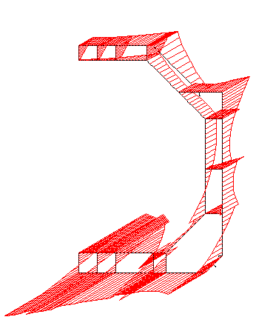
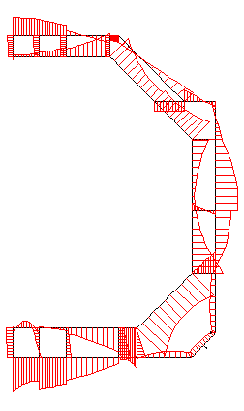
Medium Size LNG Carrier
Longitudinal Stresses
Transverse Stresses

Slide 12
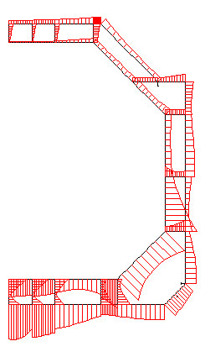
Medium Size LNG Carrier
Von-Mises Stresses

Slide 13
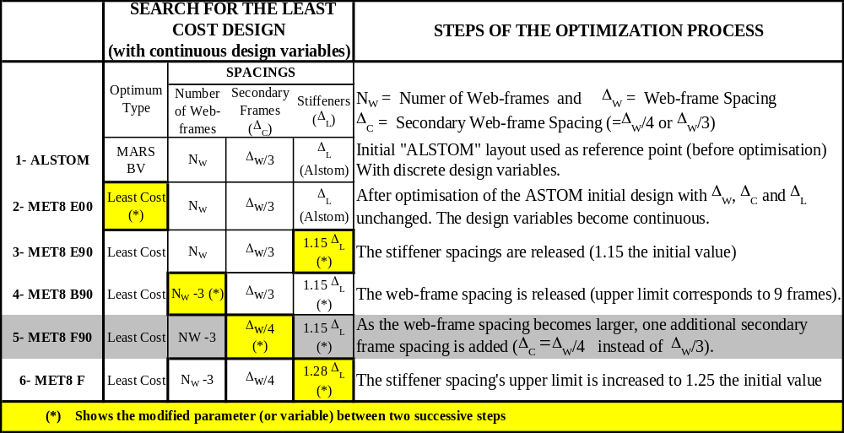
Medium Size LNG Carrier
Steps of the
Optimisation
Process
ANAST ULg

Slide 14
Medium Size LNG Carrier
Steps of the Optimisation Process
ANAST ULg

Slide 15
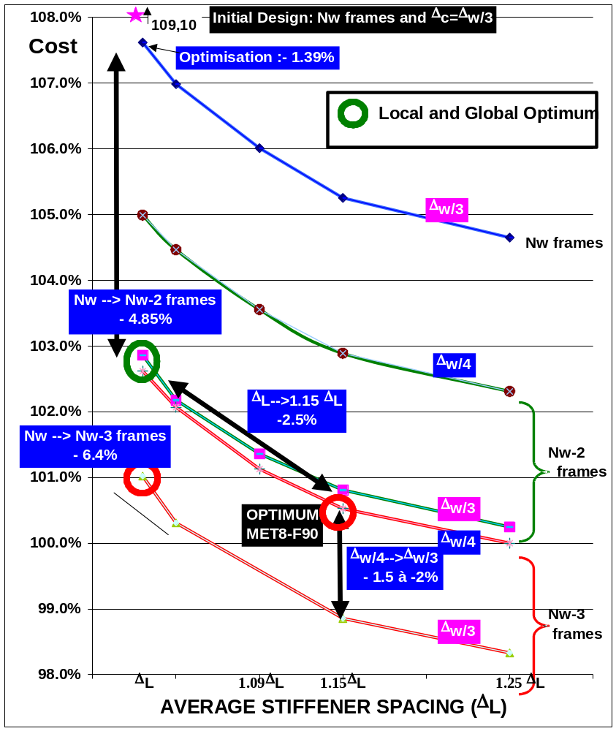
Medium Size
LNG Carrier
LEAST COST
Initial design
- N_{W} & Δ_{W} (frames)
- Δ_{C}=Δ_{W}/3
(second. Frames)
- Δ_{L} (Stiffeners)
ANAST ULg

Slide 16
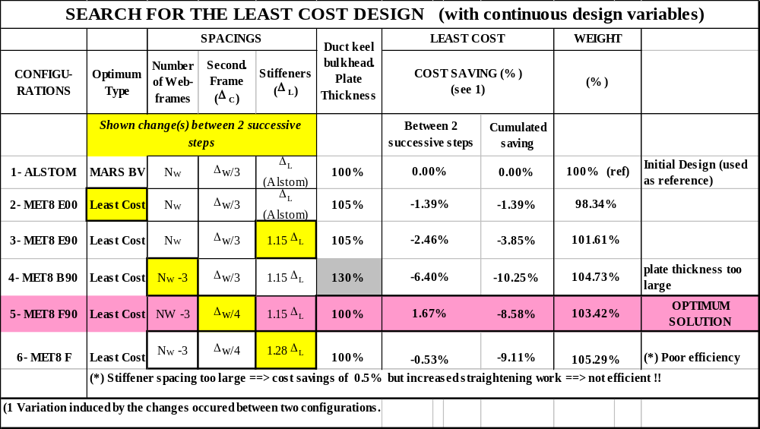
Medium Size LNG Carrier
Steps of the Optimisation Process
ANAST ULg

Slide 17
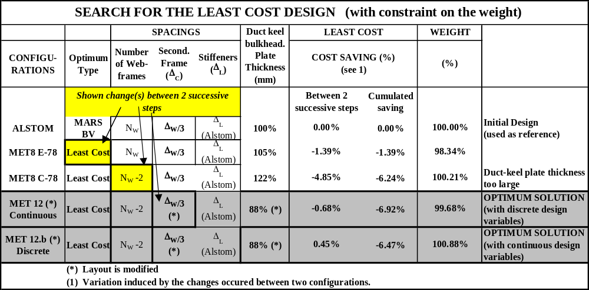
Medium Size LNG Carrier
Optimum solution with a weight constraint
ANAST ULg

Slide 18
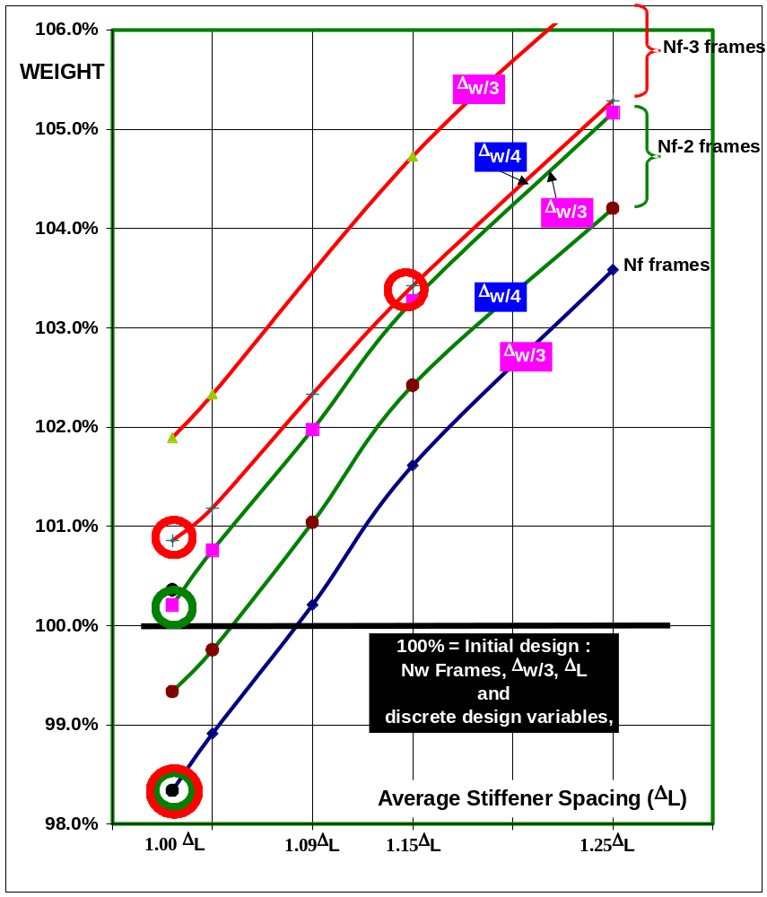
Medium Size
LNG Carrier
LEAST WEIGHT
Initial design
- N_{W} & Δ_{W} (frames)
- Δ_{C}=Δ_{W}/3
(second. Frames)
- Δ_{L} (Stiffeners)
ANAST ULg

Slide 19
Medium Size LNG Carrier
Tracks to Minimize the Construction Costs
To increase the web-frame spacing:
(N_{w} – 2) web-frames instead of N_{w} web-frames → Cost saving: 4.85 %
(N_{w} – 3) web-frames instead of N_{w} web-frames → Cost saving: 6.40 %
• To increase the stiffener spacing (Δ_{L}):
- 1.09 Δ_{L} instead of Δ_{L} → Cost saving: 1.61 %
- 1.15 Δ_{L} instead of Δ_{L} → Cost saving: 2.40 %
- 1.28 Δ_{L} instead of Δ_{L} → Cost saving: 2.97 %
(if straightening cost is not considered)
ANAST ULg

Slide 20
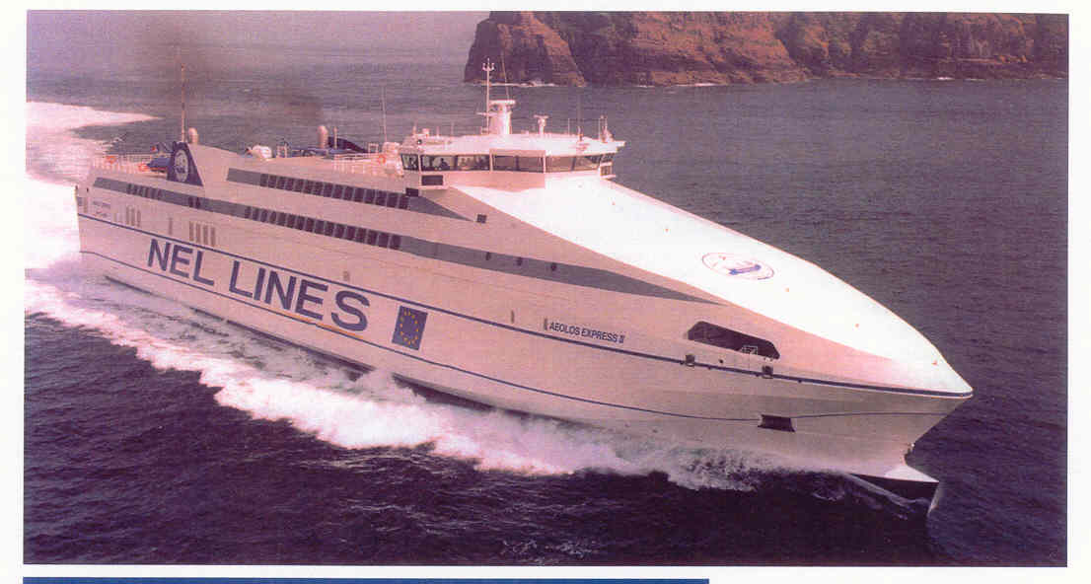
CORSAIRE 10000 : A FAST FERRY

Slide 21
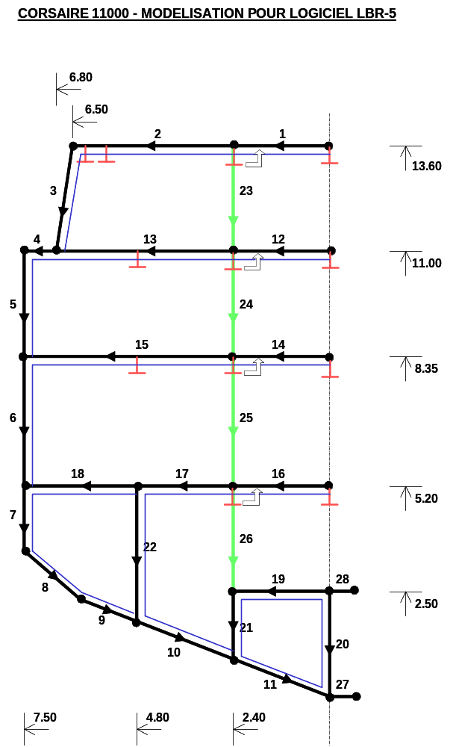
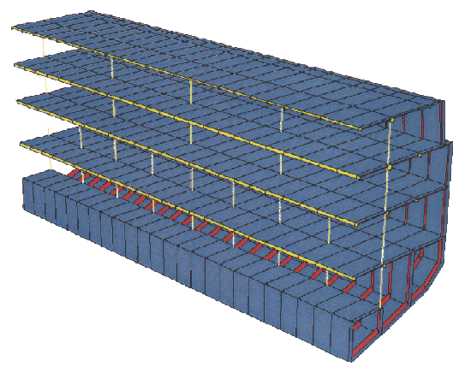
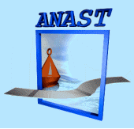
MIDSHIP SECTION DEFINED by LBR5
( → Corsaire Fast Ferry)

Slide 22
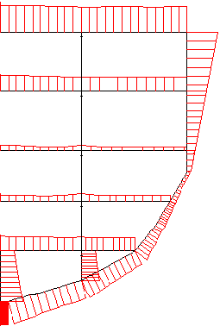
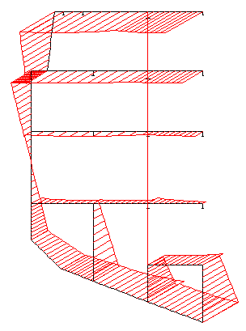
Stress induced by the maximum hull girder bending moment (Hogging and sagging)
von-Mises Stresses Longitudinal Stresses

Slide 23
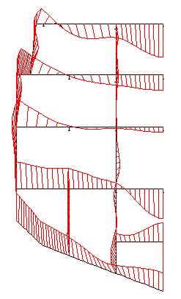
Hull deflection under Hogging bending moment

